Slide 1

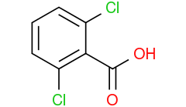

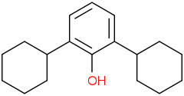
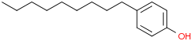
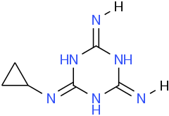


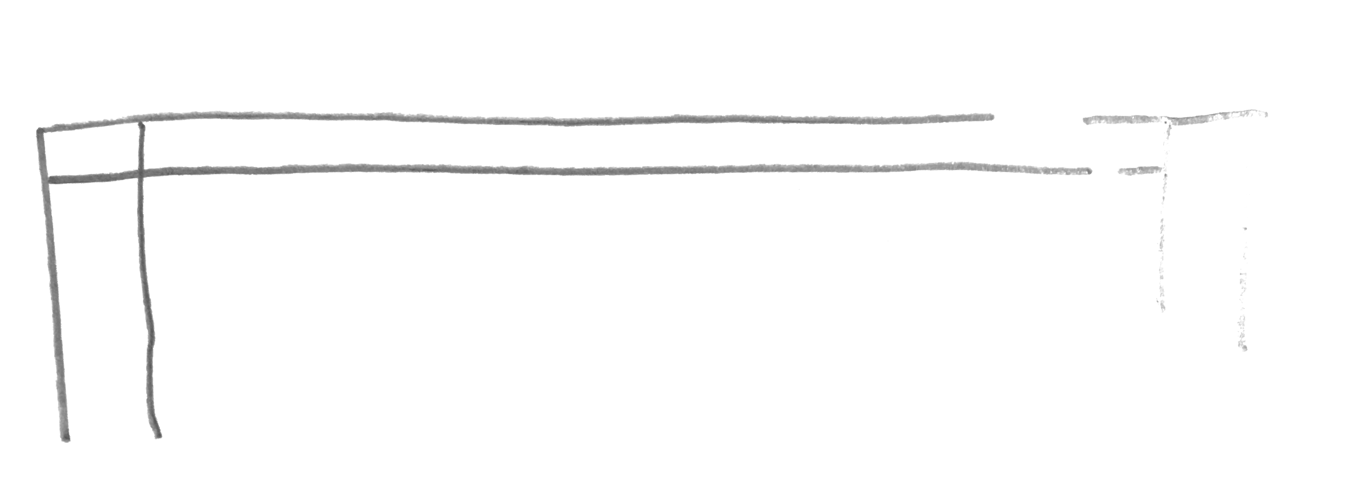
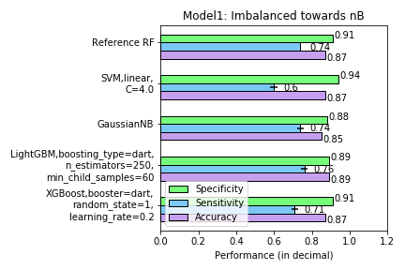
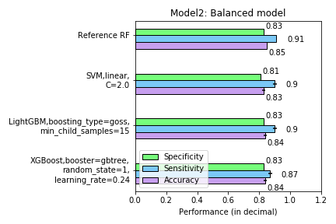
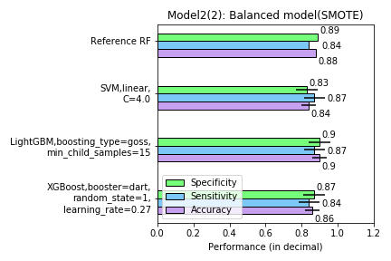
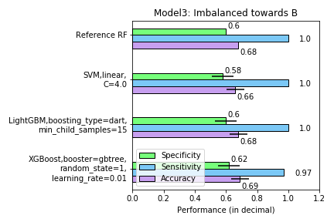
BIOCONCENTRATION FACTOR
Predicting environmental risks of chemicals using classification models
ALEKSANDRA PANFILOVA, PRASOON KUMAR, ALINA REKENA
1.
INTRODUCTION
Scientists from the University of Tartu in their earlier research¹ have developed several quantitative structure-activity relationship (QSAR) models using machine learning approaches to predict the bioaccumulation potential of chemicals. In the field of QSAR, the use of predictive machine learning algorithms is becoming popular. According to REACH legislation, for chemicals produced or imported in the European in amounts greater than 100 tons in a year, expensive and time-consuming bioaccumulation measurements are required. It means to determine if a chemical substance is not too much absorbed by an organism from ambient environment through respiratory or dermal surfaces. To help to deal with that, we can create many molecular descriptors (features) for a chemical structure (instances) and train the Machine Learning Classification models to predict if the chemical is bio-accumulative (B) or not (nB). The Regulation encourages the use of QSAR models as part of an integrated testing strategy as alternatives to animal tests. Existing models¹ have reported the accuracy of 87% maximum, however, no other predictive learning algorithms except Random Forest have been tried. The aim of the project is to improve the prediction capability of the QSAR model¹ and explore the correlation between chemical structure parameters and bioaccumulation.
2.
3.
4.
C1=CC(=C(C(=C1)Cl)C(=O)O)Cl
C1CCC(CC1)C2=CC=CC=C2O
CCCCCCCCCC1=CC=C(C=C1)O
C1CC1NC2=NC(=NC(=N2)N)N.C1CC1NC2=NC(=NC(N2)N)N
METHODS
…
CANONIC SMILES
Dataset (2.6 MB).
Four models. In order to deal with the problem of imbalanced dataset, 4 different strategies were selected:
Model_1. Imbalanced model towards nB: the original dataset which contains 209 B labels (positive class) and 798 nB labels (negative class).
Model_2. Balanced model: undersampling by randomly selecting negative labels (nB) in equal amount to positive labels (B).
Model_2(2). Balanced model (2): oversampling positive labels (B) equal to negative labels (nB) using Imblearn Synthetic Minority Oversampling Technique (SMOTE).
Model_3. Imbalanced towards B: undersampling by randomly selecting 2/3 of positive labels (B) and ¼ of that amount randomly negative labels (nB) .
Train-test-validation split. The best parameters of a Classifier were selected on the Test set. Final performances were produced on the Validation set:
Validation set: 1/3 of all instances by selecting every 3rd instance according to its ID number (334 instances).
Test set: 1/3 of the original Train set (224 instances)
Classifiers. From Sklearn library: Random Forest (for replicating the original model), Support Vector Machine, GaussianNB, XGBoost, LightGBM.
Feature selection. The same 3 molecular descriptors as selected in the original publication were used in all models:
TopoPSA: topological polar surface area, sum of surfaces of polar atoms in a molecule. It influences the ability of a compound to enter the cell.
WPATH: Wiener number, a sum of bonds between all possible pairs of atoms in a molecule. It is correlated with many chemical and physical properties of the molecule.
XLogP3: prediction of partition coefficient, measures the hydrophilicity and hydrophobicity of the chemical compound.
Additionally, the algorithm for feature selection was developed in order to get insights about how chemical structure and properties of the compound influence BCF. Features with variance below 1.0 and features with correlation to other feature above 0.9 were dropped. Then, 100 models were generated on randomly split datasets. Multiple classifiers (RF, linear SVM, XGBoost, etc.) have functions for feature importance estimation, but RF appeared to have the lowest cost. Ten features with the highest feature importance in 98 of 100 models were selected.
1007. …
551 features – molecular descriptors
RESULTS
ID
TopoPSA
WPATH
XLogP3
…
Class
Overall, Models 1 and 2(2) can achieve higher performance in specificity and accuracy, while Models 2 and 3 perform better in sensitivity.
Only Model 1 outperforms the reference model in some of the performance metrics.
LightGBM outperformed the reference model in terms of sensitivity and accuracy for Model 1.
SupportVectorMachine model with linear kernel outperformed the reference model in terms of specificity for Model 1.
Overall, the performance of LightGBM and XGBoost was very close to the reference result.
In order to improve results, Classifier-specific new feature selection would be necessary.
In some Classifiers, the performance decreased from the Test to the Validation set.
SVM with polynomial kernel took too long to execute that it was discarded after the first rounds.
Top10 most important molecular descriptors as selec-ted by Sklearn RF:
ALogP, ATSm2, ATSm4, ATSp5, SP-2, ECCEN, nHBa, nHother, nsCH3 and SsCl
are by meaning close to the 3 features used in models.
1
90.51
46
0.637
+ 548 features were kindly provided by the authors of original publication
nB
2 classes
2
…
…
…
nB
3
[3 publicly available features]
B
…
1007 instances
REFERENCES
More than 2500 models
3 improved performance metrics
1. Piir, G., Sild, S., Maran, U. SAR QSAR Environ Res. 25(12), 967-81 (2014)
ACKNOWLEDGEMENTS
The authors thank researchers Uko Maran and Sulev Sild from the Molecular Technology research group, University of Tartu, for providing the data as well as helpful assistance during this project.
Performance metrics on validation data. Error bars represent the difference in performance metrics as a result of replicating the RF model from Piir et al., 2014 in Python; marks the highest performance metrics.
Notes:
INTRODUCTION:
2,6-dichlorobenzoic acid (ID 1)
2,6-dicyclohexylphenol (ID 209)
4-nonylphenol (ID 558)
2-N-cyclopropyl-1,3,5-triazinane-2,4,6-triamine (ID 1025)
Old: "TopoPSA", "WPATH", "XLogP3”
New: "AMR", "VP-3", "SsOH"

